Slide 1
OVS DOCA - The Evolution of hardware acceleration
Maor Dickman, OVS+OVN Conference, Fall 2024

Slide 2
Agenda
• | Purpose & Motivation
• | Existing Hardware Accelerated OVS (Kernel/DPDK)
• | Vendor specific accelerations
• | What is NVIDIA DOCA?
• | OVS DOCA accelerations
• | Summary

Slide 3
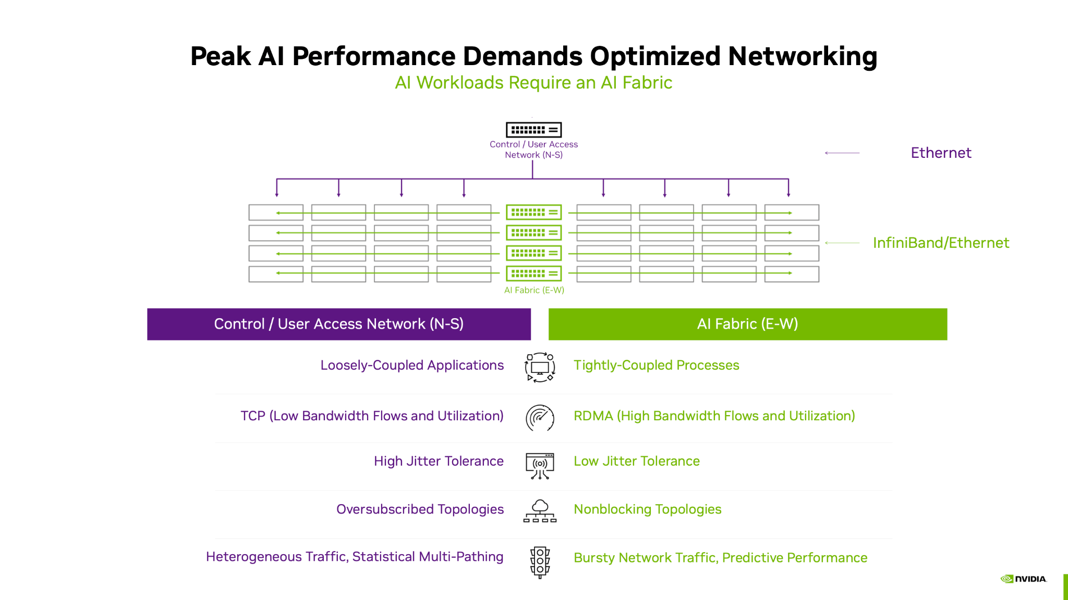
Purpose & Motivation
Data centers networking becomes ever more demanding.
  Throughput > 100G
  Low and predictable latency
  High concurrent connections
  High connections rate combined with high packet rate
  RDMA
  Security
AI workloads raise the bar, demanding more
performance, lower latency, and advanced
networking capabilities, all at a much higher
bandwidth (200/400G+)
Implications
  Current HW accelerated OVS (Kernel/DPDK) falls
  short of meeting today’s demands and
  tomorrow’s challenges
  Customers look for alternative solutions or develop
  their own OVS

Slide 4
OVS kernel Acceleration
Accelerated OVS based on Kernel API:
  Megaflows offload using TC flower (traffic control) module APIs
  Connection tracking offload using Kernel netfilter module
Pros:
  Mature - firstly introduced in OVS v2.14.0 and Linux kernel v4.10
  Large feature set
  Stable
  Generic API (no vendor specific)
Cons:
  Slow control path (low programming rate)
  Slow time to market
    Long kernel development cycles
    Long time till change propagated to Linux distribution
  Feature set depend on running kernel
  TC API is limited and can’t support advanced HW features (dp_hash for example)
  High latency for non-offloaded packets
  Slowpath performance doesn’t meet requirements
  Risky - bug in kernel can crash the system
CLI
OpenFlow
OVS
DPIF Netdev (DPDK)
DPIF Netlink (kernel)
Netdev Offload (DPDK)
Netdev Offload TC
DPDK rte_flow
TC
PMD driver
Kernel driver
Hardware
Legend
Community
Vendor specific

Slide 5
OVS DPDK Acceleration
Accelerated OVS DPDK using rte_flow API
Pros:
  Kernel bypass
    faster control path (higher programming rate)
    faster slowpath
  No kernel dependency
Cons:
  Poor feature set
  DPDK rte_flow API is too low level
    Missing HW abstraction
    Requires consensus from all vendors
  rte_flow API is limited and can’t support advanced HW features (dp_hash
  for example)
  Connection tracking offload not supported
CLI
OpenFlow
OVS
DPIF Netdev (DPDK)
DPIF Netlink (kernel)
Netdev Offload (DPDK)
Netdev Offload TC
DPDK rte_flow
TC
PMD driver
Kernel driver
Hardware
Legend
Community
Vendor specific

Slide 6
OVS new model

Slide 7
Vendor specific Accelerations
Each vendor will implement its own offload API
  Vendor specific DPIF
  Implement both offload and slowpath handling
Full flexibility
  Allow each vendor to define its own HW access model
  while still be align with OVS APIs
Largest feature set
  Full utilization of HW capabilities with vendor own APIs
Fastest programming rate (CPS)
  Direct access to HW from userspace
  No need to cross multiple layers
Best offload performance (PPS)
  Optimized usage of HW APIs and resources
Time to market
  No dependency on 3rd party development and release cycles
CLI
OpenFlow
OVS
DPIF Netdev (DPDK)
Vendor specific DPIF
DPIF Netlink (kernel)
Netdev Offload (DPDK)
Netdev Offload TC
DPDK rte_flow
TC
PMD driver
Kernel driver
Hardware
Legend
Community
Vendor specific

Slide 8
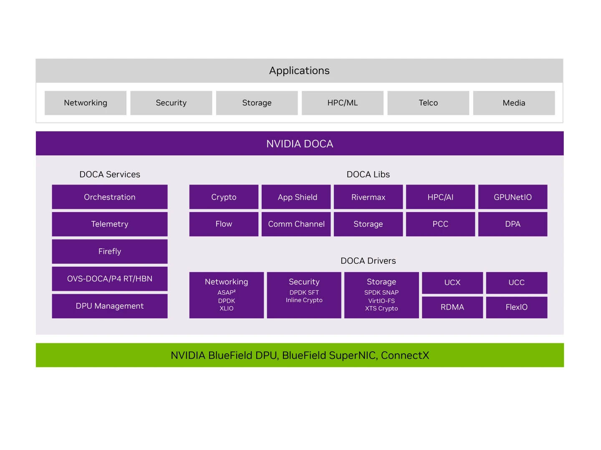
What is NVIDIA DOCA?
NVIDIA DOCA package contains services, libraries and drivers for NVIDIA NICs management and programmability.
DOCA drivers - Linux drivers and DPDK for HW access.
DOCA libraries - industry-standard open APIs for network acceleration
  DOCA DMA - API for HW accelerated data copy
  DOCA Flow - API for building generic packet processing pipes in hardware.
    DOCA Flow Connection Tracking (CT)
  DOCA ETH - API for send/receiving packets
  DOCA Compress - HW accelerated compress/decompress API
DOCA services - DOCA-based products.
  DOCA Firefly - Time synching service through precision time
  protocol (PTP)
  Host-based Networking (HBN) - allow designing a network
  purely on L3 protocols
  OVS-DOCA - OVS with DOCA acceleration.

Slide 9
OVS DOCA Acceleration
Highly optimized vSwitch for Nvidia Network Services
Based on NVIDIA DOCA SDK which provides industry-standard open APIs and software frameworks for NVIDIA networking acceleration.
Implement new DOCA DPIF which utilize DOCA-FLOW library
for offloads.
  DOCA-FLOW is NVIDIA SW API for Network acceleration
  Uses Hardware steering (HWS) offload for best programing rate (x10+)
No impact on existing DPDK and Kernel DPIFs
Preserves existing northbound APIs (OpenFlow)
  Supported with OVN-24.03 and OVN-K8s GA 1.0
    https://ovn-kubernetes.io/features/hardware-offload/ovs-doca/
Support extended feature set
  Tunnels: vxlan, gre and Geneve
  Optimized Connection tracking (PPS+CPS)
  DP_HASH
  sFLOW
Perform extremely well
  Slow path handling, insertion rate (CPS), Optimized pipes (PPS)
CLI
OpenFlow
OVS
DPIF Netdev (DPDK)
DPIF DOCA
DPIF Netlink (kernel)
Netdev Offload (DPDK)
DOCA Offload
Netdev Offload TC
DPDK rte_flow
DOCA FLOW
TC
PMD driver
Kernel driver
Hardware
Legend
Community
NVIDIA

Slide 10
OVS DOCA release and roadmap
NVIDIA OVS-DOCA is globally available as part of DOCA package (current version 2.9)
Based on upstream OVS LTS 3.3
Supported features:
  VLAN
  Tunnels: VLXAN, GRE, GENEVE+options.
  Header rewrite
  Connection tracking (with and without NAT)
  sFLOW
  Mirroring
  DP_HASH
  Meter
  Hairpin
  Bonding (high availability)
Download:
  https://developer.nvidia.com/doca-downloads
User manual:
  https://docs.nvidia.com/doca/sdk/nvidia+openvswitch+acceleration+-+ovs+in+doca/index.html
Roadmap:
  Upstream DOCA DPIF
  Live update (Nov2024 LTS)
  Security acceleration (IPSec and PSP)
  Improved debuggability
  Scale

Slide 11




Summary
OVS-DOCA improves performance metrics for both fastpath and slowpath to meet existing and future networking demands while maintaining compatibility with the OVS architecture.
OVS-DOCA surpassed both kernel and DPDK versions in performance and features
 | OVS-Kernel | OVS-DPDK | OVS-DOCA
Acceleration​ | Accelerated | partially accelerated | Accelerated
Slowpath perf
CPS​
Fastpath perf | (*Fastpath offloaded) | (*In price of more CPU)
CPU usage
Time to market

Slide 12
Thank you!
Questions?
Example Slides

